Slide 1
Fraud Detection: Final Results
Machine Learning Project
Joshua Francis and Logan Digilormo
Notes:
JOSH: Hello everyone, I'm Josh, and this is Logan. This is our final presentation on detecting credit card fraud with machine learning. We'll cover our data and features, dimensionality reduction with PCA and t-SNE, time-aware cross-validation, the final results, and a live demo of a scoring app we built. Logan will begin by recalling the problem.

Slide 2
The problem and our goal
Goal
Predict whether a transaction is fraud.
Challenge
Fraud is only 1.2% of transactions.
Our yardstick
Precision, recall, F1, and PR-AUC, never accuracy alone.
Illustration: about 1 fraud in every 100 transactions
Notes:
LOGAN: Thanks, Josh. Our goal is to flag fraudulent credit card transactions from the amount, category, time, and a customer's own history. The challenge is that fraud is rare: 1.2% of our 822,484 simulated transactions, or roughly one in a hundred, as in this picture. A model therefore has to find a few needles in a large haystack, and plain accuracy would be misleading. Josh will describe the data and features.

Slide 3





Data and features
Base and category
Time
Distance
History
Amount, age, city size, and 14 category columns.
Hour, weekday, weekend, and night flags.
Haversine miles from home to the merchant.
Gaps, speed, amount vs average, recent counts.
Dataset: 822,484 simulated transactions, 999 customers, 1.2% fraud.
Notes:
JOSH: We generated 822,484 transactions for 999 customers across 2025 with the public Sparkov tool, so no private data is involved. From the raw columns we built 31 model inputs in four groups: base details, time, distance from home, and customer history. The history features, such as the amount compared with a customer's average, use only that customer's earlier purchases, so nothing leaks from the future. Logan will show how we reduced the dimensionality of these inputs.

Slide 4
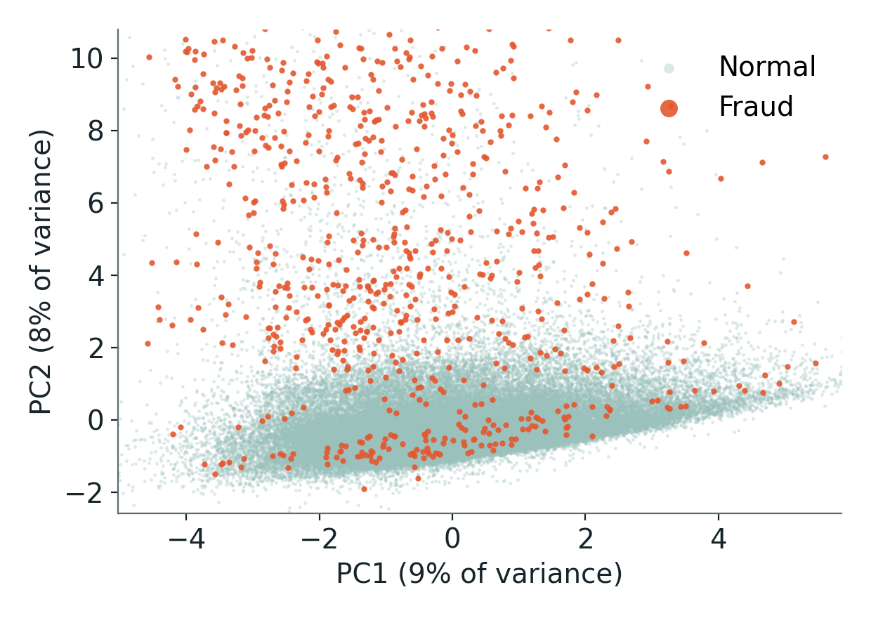

Dimensionality reduction: PCA
Share of variance explained by each component
First two components (60,000 sampled transactions)
25 of 31 components keep 95% of the variance. The first two keep 17%: PC1 tracks recent activity, PC2 tracks amount.
Notes:
LOGAN: Our 31 inputs overlap a lot, so we applied principal component analysis, or PCA, which rotates the data into new directions ordered by how much variation they carry. It takes 25 of the 31 components to keep 95 percent of the variance, and the first two keep 17 percent. The first component mostly reflects recent activity, such as purchases in the last day, and the second mostly reflects amount. In the two-dimensional view, fraud overlaps normal activity heavily, so no simple projection separates it. Josh will show a nonlinear view and what happens when models use the reduced inputs.

Slide 5
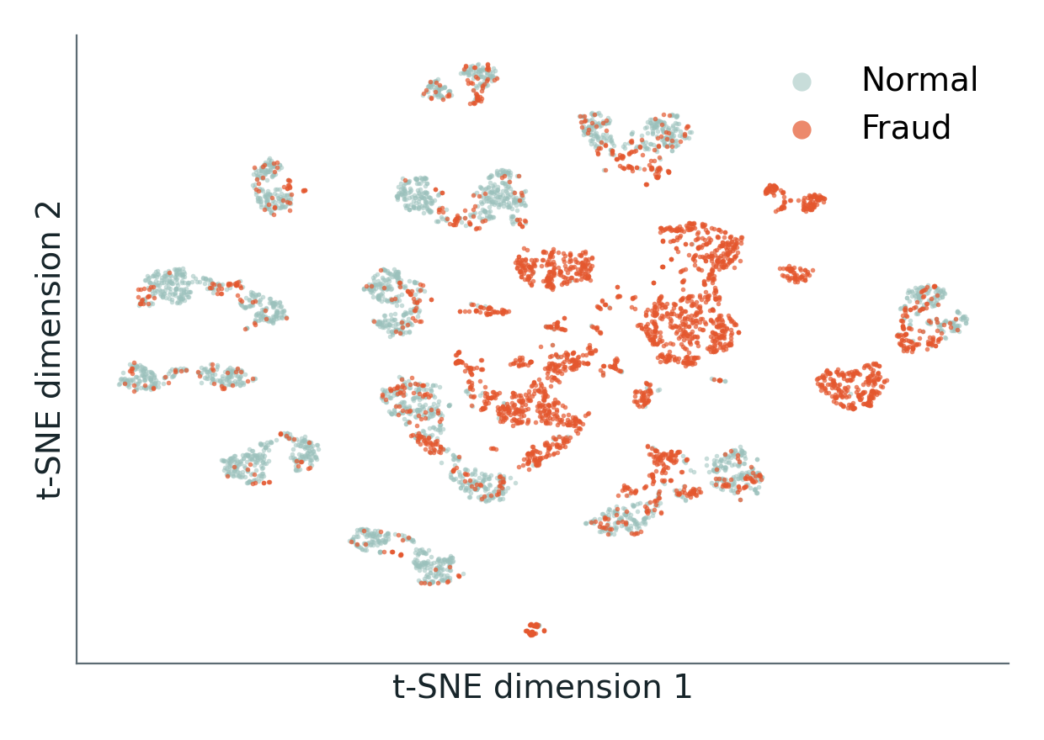

t-SNE and PCA in the models
t-SNE: 3,000 fraud and 3,000 normal transactions
Test PR-AUC with and without PCA inputs
Fraud forms local clusters (84% of a fraud point's 10 nearest neighbors are fraud). Random forest keeps 0.70 of 0.76 after PCA on continuous inputs, but only 0.004 after PCA on all 31 features.
Notes:
JOSH: To look for structure that PCA can't show, we used t-SNE, a nonlinear method, on a balanced sample of 3,000 fraud and 3,000 normal transactions. Fraud forms local clusters: on average 84 percent of a fraud point's ten nearest neighbors are also fraud. We then trained the models on reduced inputs. Applying PCA to only the 13 continuous features keeps most of the performance, with the random forest at 0.70 versus 0.76. Applying PCA to all 31 features collapses it to 0.00, because the fraud signal sits in flags and categories that the rotation scrambles. We did not test that explanation separately. Logan will explain how we validated the models.

Slide 6

Methods and cross-validation
Jan 1 to Mar 14
Mar 14 to May 10
May 10 to Jun 28
Jun 28 to Aug 13
Aug 13 to Oct 5
Oct 5 to Nov 30
Test month
Fold 1
Fold 2
Fold 3
Fold 4
Fold 5
Train
Validate
Not used in this fold
Held out until the end
Mean PR-AUC across the 5 folds: random forest 0.73 ± 0.10, decision tree 0.48 ± 0.30, gradient boosting 0.56 ± 0.19.
Notes:
LOGAN: We used time-aware cross-validation. The January to November development period is cut into six chunks, and in each of five folds the models train on the earlier chunks and validate on the next one, so they never see the future. We picked each model's settings by average PR-AUC across the folds, and chose its decision threshold from the pooled validation predictions. Then each model was refit on the whole development period and tested once on December. All four models optimize cross-entropy: logistic regression and gradient boosting minimize log loss directly, and the tree and forest split on entropy. The folds also show how unstable some models are: the random forest averages 0.73 with a spread of 0.10, while gradient boosting's spread is 0.19. Josh will compare the results.

Slide 7
Model comparison
0.76
PR-AUC for the random forest, with precision 0.81 and recall 0.65.
Notes:
JOSH: Here are all four models on the test month, next to their cross-validated scores. The random forest is best on both: a test PR-AUC of 0.76, an F1 of 0.72, and a cross-validated PR-AUC of 0.73 with a spread of 0.10. The decision tree reaches 0.69, and gradient boosting 0.66, although its F1 is only 0.30 because the threshold chosen in cross-validation was too strict for the refit model, so PR-AUC is the fairer comparison. Logistic regression fails, with a PR-AUC of 0.006, because fraud depends on combinations of features that a straight-line model cannot express. Logan will look closer at the best model.

Slide 8
Best model in detail
373
85
Fraud caught
False alarms
198
122,717
Fraud missed
Normal, left alone
Trade-off: the tuned threshold balances false alarms against missed fraud.
Notes:
LOGAN: On the test month, the random forest caught 373 of 571 fraud cases and raised 85 false alarms among about 122,802 normal transactions. That's a precision of 0.81 and recall of 0.65 at a threshold of 0.88. The threshold matters a lot: at the default of 0.5, its F1 would drop to 0.36. The curve shows the trade-off between catching more fraud and raising more false alarms. Josh will explain what drives these predictions.

Slide 9
What drives fraud
Notes:
JOSH: This chart shows which features the random forest relies on most, measured by how much performance drops when we shuffle each one. Amount is the clear leader, followed by the night flag and the hour of day. Amount compared to the customer's own average also ranks high, which is one of our history features. Distance from home does not appear, which matches what we saw in the data. Logan will test whether the feature groups really help.

Slide 10

Do our features help?
History helps: PR-AUC rises from 0.57 to 0.77; distance adds nothing here.
Notes:
LOGAN: We tested this with an ablation, retraining the random forest on different feature groups and scoring each on the test month. A base model with amount, time, and category scores a PR-AUC of 0.57. Adding the history features lifts it to 0.77, a large gain. Adding distance does not help: 0.52. Removing distance and speed from the full set changes nothing meaningful, 0.76 versus 0.76. So the history features earned their place, while distance did not in this data. Josh will show the demo.

Slide 11

Live demo
12
0
98
69
Looks normal
Looks normal
Likely fraud
Worth a look
Coffee near home
Gas on a road trip
Late-night electronics
Big evening purchase
Biggest mover: amount
Biggest mover: recent activity
Biggest mover: amount
Biggest mover: amount
Run it live: start the server, then open the app in a browser and score two scenarios.
Notes:
JOSH: We built a small web app that scores a transaction with all four models. A coffee near home scores 12 out of 100 and looks normal. An 890 dollar online purchase at two thirty in the morning scores 98 and is flagged as likely fraud, driven mostly by amount and time of day. A large evening purchase near home scores 69, which the app labels worth a look. The app also shows what moved each score. I will now run it live. Logan will cover the limitations.

Slide 12



Limitations and lessons learned
Simulated data
No distance signal
Fraud drifts
Thresholds matter
Results may not transfer to real-world spending.
Fraud is no farther from home in this generated data.
1.3% in Jan-Nov versus 0.5% in the test month.
Random forest F1: 0.72 tuned, 0.36 at 0.5.
Lessons: accuracy alone misleads (98.8% for guessing "not fraud"), and history features must use only the past.
Notes:
LOGAN: We want to be clear about the limits and lessons. The data is simulated, so results may not transfer to real spending. Distance from home carried no signal in this generator. Fraud also drifts over time: 1.3% of January to November transactions were fraud, but only 0.5% in the test month, and cross-validation scores varied across folds. The main lessons were that accuracy is a trap, that thresholds do not always transfer, and that features must use only the past. Josh will summarize the conclusions.

Slide 13


Conclusions and future work
Best model
History matters
Reduction has a cost
Random forest: F1 0.72, PR-AUC 0.76.
PR-AUC 0.57 to 0.77 with history features.
PCA on continuous inputs: forest 0.70 vs 0.76.
Future work: real data with permission, cost-based thresholds, and generator settings where travel matters.
Notes:
JOSH: We have three main findings. First, the random forest was our best model, with a test F1 of 0.72, a test PR-AUC of 0.76, and the most stable cross-validation scores. Second, customer-history features mattered most, lifting PR-AUC from 0.57 to 0.77. Third, dimensionality reduction helped us understand the data but not the models: PCA on the continuous features kept most of the performance, and PCA on everything did not. Distance from home, our original idea, did not help in this simulated data. For future work we would try real data with permission, cost-based thresholds, and generator settings where travel matters. Logan will close.

Slide 14

Thank you and questions
Josh
Logan
Models: Logistic regression and Decision tree
Also: Feature pipeline and the ablation study
Models: Random forest and Gradient boosting
Also: Tuning and threshold choice
Together: scoring demo, decks, final report, and the GitHub repository.
Notes:
LOGAN: Thanks, Josh. To recap who did what: Josh built the logistic regression and decision tree, the feature pipeline, and the ablation. I built the random forest and gradient boosting and handled tuning and thresholds. We built the demo, the decks, and the report together, and all the code is in our GitHub repository. Thank you, and we are happy to take questions.

